Slide 1

Benefits of International Trade
4.1
Copyright Bananaomics

Slide 2

Do you think countries benefit from trade? Why or why not?
Copyright Bananaomics

Slide 3

Definition
Free Trade
No barriers to trade between countries
Copyright Bananaomics

Slide 4
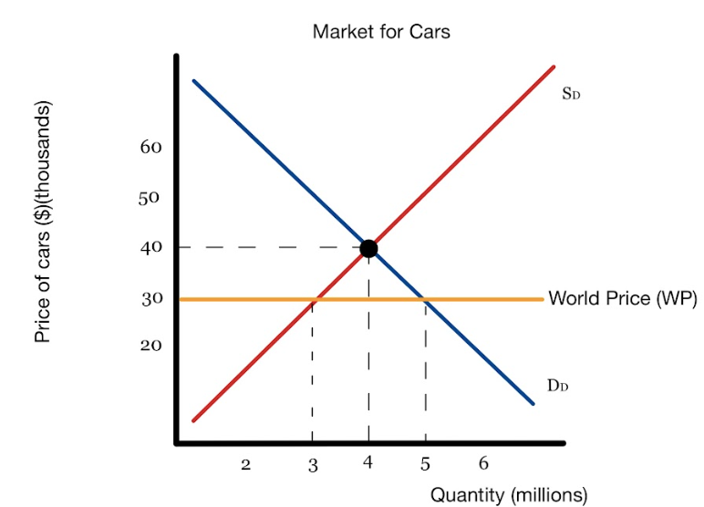
Free Trade Diagram
Copyright Bananaomics

Slide 5
Free Trade Diagram
Before Trade
How much did domestic firms make from selling cars?
How much was the domestic consumer surplus? Domestic producer surplus?
After Trade
What happened to price level?
What quantity is being sold domestically?
What quantity is being imported?
How much did domestic firms make from selling cars?
How much did foreign firms make from selling cars?
What happened to the domestic consumer and producer surplus? Is there more total surplus before or after trade?
Copyright Bananaomics

Slide 6
Free Trade Diagram
Before Trade
What quantity is being sold domestically?
4 (millions)
How much did domestic firms make from selling cars?
160,000 (millions)
After Trade
What happened to price level?
Decreased to 30 (thousands)
What quantity is being sold domestically?
3 (millions)
What quantity is being imported?
2 (millions)
How much did domestic firms make from selling cars?
90 (millions)
How much did foreign firms make from selling cars?
60 (millions)
What happened to the domestic consumer and producer surplus? Is there more total surplus before or after trade?
Copyright Bananaomics

Slide 7

Benefits of International Trade
Copyright Bananaomics

Slide 8

Benefits to International Trade
Increased competition
Lower prices
Greater choice
Acquisition of resources
More foreign exchange earnings
Access to larger markets
Economies of scale
More efficient resource allocation
More efficient production
Copyright Bananaomics

Slide 9

Increased Competition
International trade allows for firms in other countries to compete with one another, leading to increased competition and higher quality.
Copyright Bananaomics

Slide 10

Lower Prices
Countries are able to specialize and use economies of scale to decrease their costs of production and sell their products at a lower price.
Copyright Bananaomics

Slide 11

Greater Choice
Free trade enables domestic consumers to have a greater choice as they are able to select goods/services domestically and internationally.
Copyright Bananaomics

Slide 12



Acquisition of Resources
Each country has access to specific natural resources. Free trade allows for countries to sell their resources for production in other countries.
Copyright Bananaomics

Slide 13

Foreign Exchange Earnings
Foreign Exchange earnings refer to financial gains made by currencies exchanging on the global market.
Copyright Bananaomics

Slide 14

Access To Larger Markets
Individual firms would have access to a global market instead. of being limited to their domestic market. Free trade allows companies to become multi-national and gain more consumers.
Copyright Bananaomics

Slide 15

Economies of Scale
Larger markets allow firms to gain larger revenue. Firms have the option to invest that revenue into increasing efficiency and lowering costs.
Copyright Bananaomics

Slide 16

Efficient Resource Allocation and Production
Free trade allows countries to allocate their resources as efficiently as possible and gives firms access to raw materials that ensure their production costs are as low as possible.
Copyright Bananaomics

Slide 17

Comparative and Absolute Advantage
Copyright Bananaomics

Slide 18

Definitions
Absolute Advantage
When a country can produce more with equivalent resources.
(They are absolutely better at producing it).
Comparative Advantage
When a country can produce a good at a lower opportunity cost compared to another country.
(Comparative advantage helps countries determine what they should trade)
Copyright Bananaomics

Slide 19


Two Types Scenarios
The advantage with a focus on Output
Which country can produce the highest quantity?
Ex: China can make 60 trampolines while the USA can only make 50.
Who is more efficient?
The advantage with a focus on Input.
Which country can make a quantity of a good with the lowest amount of resources.
Ex: Joe takes 2 hours to mow the lawn while it takes Carl 4 hours.
Who is more efficient?
Copyright Bananaomics

Slide 20

Sources of Comparative Advantage
Factor/Resource Endowment
Some countries have access to resources that makes production easier.
Levels of Technology
Some countries have access to technologies that make them more efficient in the production of certain goods.
Copyright Bananaomics

Slide 21

Calculating Comparative Advantage
In order to determine the comparative advantage, you must calculate the opportunity cost for producing one of each good.
Output: Other (#) goes Over (OOO)
Input: Other (#) goes Under (IOU)
Copyright Bananaomics

Slide 22


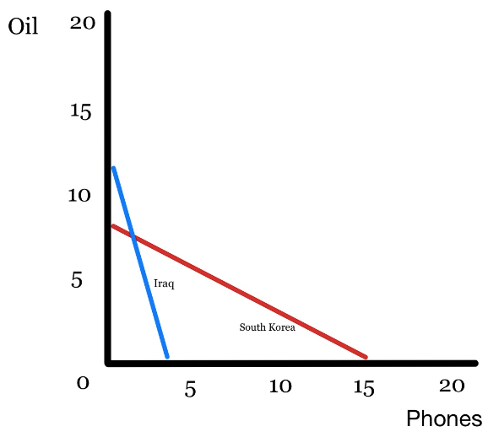
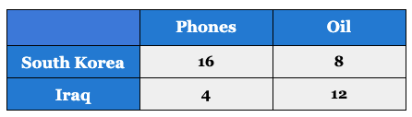


Example
Copyright Bananaomics

Slide 23
Practice
Absolute Advantage
Who has an absolute advantage in producing phones?
Who has an absolute advantage in producing oil?
Comparative Advantage
Who has an absolute advantage in producing phones?
Who has an absolute advantage in producing oil?
Copyright Bananaomics

Slide 24
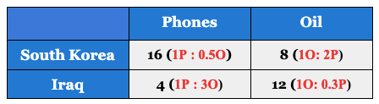
Example
Absolute Advantage
Who has an absolute advantage in producing phones? South Korea
Who has an absolute advantage in producing oil? Iraq
Comparative Advantage
Who has an absolute advantage in producing phones? South Korea
Who has an absolute advantage in producing oil? Iraq
South Korea should export and specialize in phones while Iraq should export and specialize in Oil.
Copyright Bananaomics

Slide 25
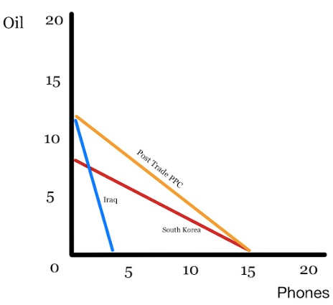
Before Trade & After Trade PPC
Copyright Bananaomics

Slide 26


Opportunity Cost Calculation Cheat
NOTE: This cheat is only to assist you with quick calculations or to check your work. It should never be used in an answer
Cross multiply numbers in the box to quickly determine competitive advantage.
Output problem: take the number that gives you the most production (highest)
Input problem: take the number that requires the fewest amount of resources (lowest)
32
224
Copyright Bananaomics

Slide 27

Comparative Advantage - ACDC Econ
Copyright Bananaomics

Slide 28
Limitations of Comparative and Absolute Advantage
Copyright Bananaomics

Slide 29

Limitations of Comparative Advantage
Problems or issues with comparative advantage:
  Only 2 goods and 2 countries (simplified and unrealistic)
  Assumption of full employment
  Assumption of perfect information
  Assumption that technology is fixed
  No calculation of the cost of transportation between countries
Copyright Bananaomics

Slide 30

Practice Question
Copyright Bananaomics

Slide 31

Paper 1
Copyright Bananaomics

Slide 32
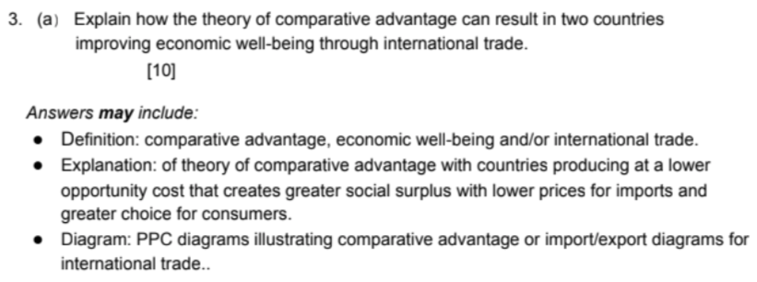
Mark Scheme
Copyright Bananaomics

Slide 33

Enjoying The Content?
Visit bananaomics.com to purchase package deals with discount prices!
BANANAOMICS

